Slide 1
Digging deep into docker
(Networking)

Slide 2
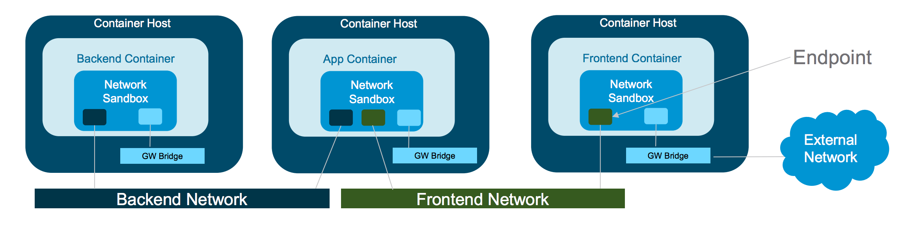
Container networking high-level diagram
Notes:
Sandbox - it is the running container’s network stack. An e.g. implementation is Linux Namespaces or FreeBSD jail
Endpoint - it joins running containers’ network stack to actual network like Host’s network or any other. E.g. Veth Pair in Linux
Network - group of endpoints that can talk with each other. E.g. Linux Bridge

Slide 3
Before jumping into docker networking internals..
Network namespace - primer
Virtual network interface - primer
Iptables - primer
Notes:
Iptables - https://www.digitalocean.com/community/tutorials/how-the-iptables-firewall-works
Virthual ethernet device pair - veth ( http://www.axeman.in/blog/2014/12/09/build-your-own-lxc-contain-it-yourself/ ) for real demo of how to create veth pair and
ip link add veth-2 type veth peer name veth-3
ip link set veth-2 netns namespace1
ip netns exec namespace1 ifconfig veth-2 10.1.1.1/24
Network namespace - http://www.axeman.in/blog/2014/12/09/build-your-own-lxc-contain-it-yourself/
Create namespace - ip netns add namespace1
Execute ip addr in it - ip netns exec namespace1 ip addr
To understand what we need from a networking point of view for a container to run, let’s create our container by few linux commands without docker. ( Mankar’s demo )

Slide 4
Responsibilities of container networking layer
IP connectivity in Container’s network ( Linux network namespace, FreeBSD Jail or similar concept )
IP address management ( IPAM )
Network device creation etc.
External connectivity via Host NAT

Slide 5
Design requirements of container networking layer
Should be usable on any underlying data center tech ( on-premise / public )
Should be pluggable to any kind of underlying networking solution that can be abstracted with EndPoints, SandBox and Networks. ( mentioned on previous slide )
Should leave the choice of implementing these things to network vendors via plugin / driver model
Implementation of these networking layers are
CNM ( Container networking Module ) - docker and only docker
CNI ( Container networking Interface ) - everyone else
Notes:
As a general software engineering practice, container platform like docker-engine / rkt or Mesos or Graden, adheres to few design requirements when implementing their networking layer. This is so that, any container from different container runtime can work
Implementation of these networking responsibilities in Container world is done via two main approaches.
CNM ( container networking module )
CNI ( container networking interface )

Slide 6
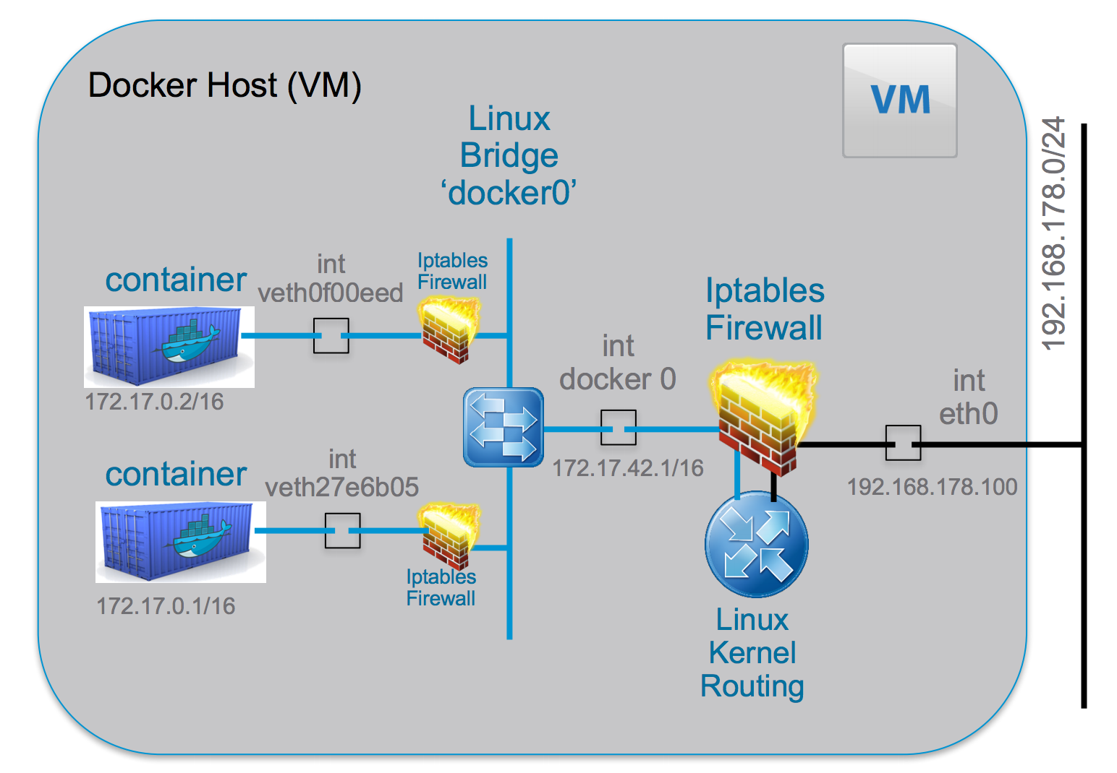
Docker engine - default network diagram ( Bridge )
Notes:
Main things to look out:
Virtual interfaces:
Every container when it is started CNM / libnetwork created one pair of virtutal ethernet device pair for it ( Veth ). It connects one end of it to container’s network namespace aka Sandbox and other end to the default docker0 bridge ( on linux at least ).
Run a container and do brctl show docker0
Run tcpdump from host on given virtual interface
Run ping google.com from inside container.
Run another container and ping to first container from it.
Run tcpdump from host on for docker0 bridge. ( to demonstrate why docker bridge is important )
Iptables:
Sudo iptables -t filter -L ( on host ) to show the POSTROUTING chain which does nat translation.
Sudo iptables -t filter -L ( inside container ) to show how container networks are isolated from each other.
Iptables are used by docker for exposing Ports to external world via port mapping. ( run a container and do iptables -t nat -v )

Slide 7
Different network drivers
Bridge - Single Host. Explained in Previous slide. Very relevent for local development
Overlay - Multi Host. Used in Docker Swam.
Macvlan - Single Host, but light weight than Bridge, as it directly connects to physical network interfaces on host.
Notes:
Purposefully avoiding talking about Overlay and MacVLAN as there not relevant for us as of now. Because, AWS ECS uses CNI model to achieve multi-host networkiing. So understanding these network drivers and their architecture is more specific to swarm. As that’s where it’s used mostly. But one should definitely know about them.

Slide 8
Further study topics
Kubernetes networking with Pod and flat network space
Mesos networking
Service discovery in the world of containers
Reverse engineering ECS containers ( as it’s not open sourced, you have to ssh into container instances and run few linux commands to explore )

Slide 9
Few useful network commands
ip link
brctl
netns
nsenter
ps
docker :)

Slide 10
References
http://securitynik.blogspot.in/2016/12/docker-networking-internals-how-docker_16.html#Overview ( docker networking demo )
http://www.axeman.in/blog/2014/12/09/build-your-own-lxc-contain-it-yourself/ ( build your own container by linux command demo )
https://www.digitalocean.com/community/tutorials/how-the-iptables-firewall-works ( iptables primer )
http://events.linuxfoundation.org/sites/events/files/slides/2016%20-%20Linux%20Networking%20explained_0.pdf ( virtual interfaces and linux networking demo )
https://blog.docker.com/2016/12/understanding-docker-networking-drivers-use-cases/ ( docker networking drivers details )
https://thenewstack.io/hackers-guide-kubernetes-networking/ ( kubernetes networking reverse engineering )
http://www.innervoice.in/blogs/2013/12/02/linux-bridge-virtual-networking/ ( linux bridges )
https://github.com/kubernetes/community/blob/master/contributors/design-proposals/network/networking.md ( kubernetes networking and CNI )
https://platform9.com/blog/container-namespaces-deep-dive-container-networking/
https://blog.scottlowe.org/2013/09/04/introducing-linux-network-namespaces/ ( linux network namespace tutorial )

